Slide 1
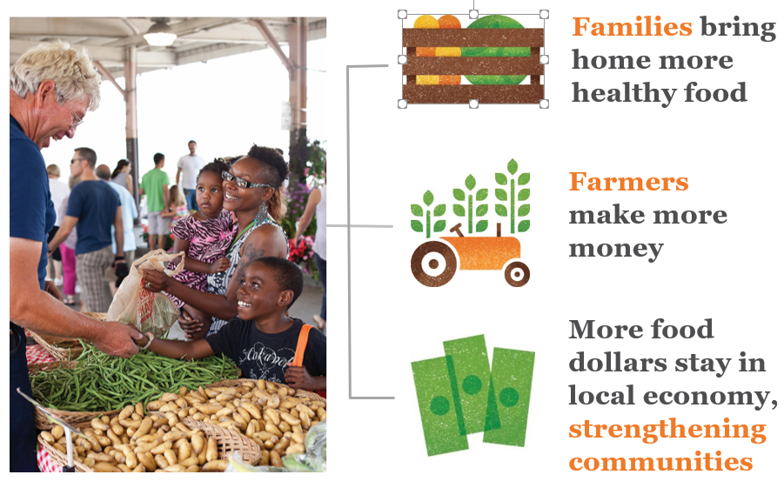
Double Up Food Bucks A National Model for Healthy Food Incentives
Notes:
Donna

Slide 2
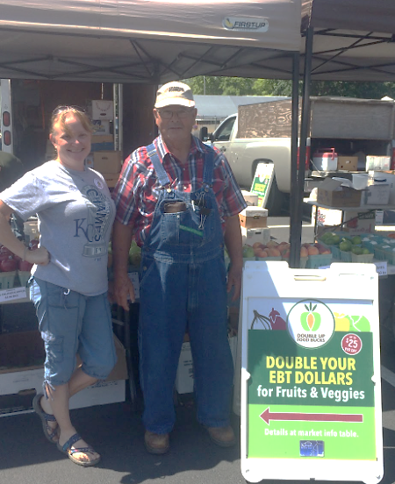
How it Works
Farmers Markets
SNAP tokens are purchased with an EBT card at a participating farmers market information booth. SNAP tokens can purchase any SNAP eligible item at the market.
Double Up Food Buck (DUFB) tokens are given as a match ($25 per day). DUFB tokens can purchase any fresh vegetables and fruits at the market.
Customer shops at vendors they choose!
Notes:
Erin

Slide 3
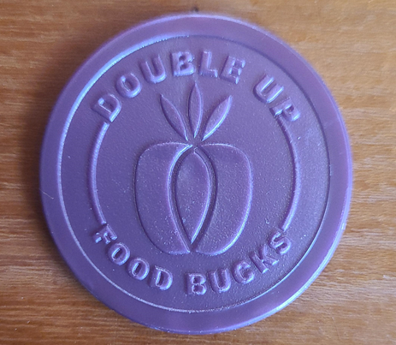
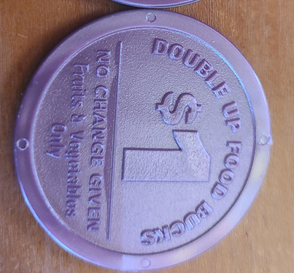
Tokens
Tokens are PURPLE through 2024!
No longer accepting ORANGE or SILVER tokens.
Vendors will not be reimbursed for orange or silver tokens
No change given/ No sales tax charged
Notes:
Silver tokens were used in Wichita last year- orange tokens were used with the rest of the markets.

Slide 4
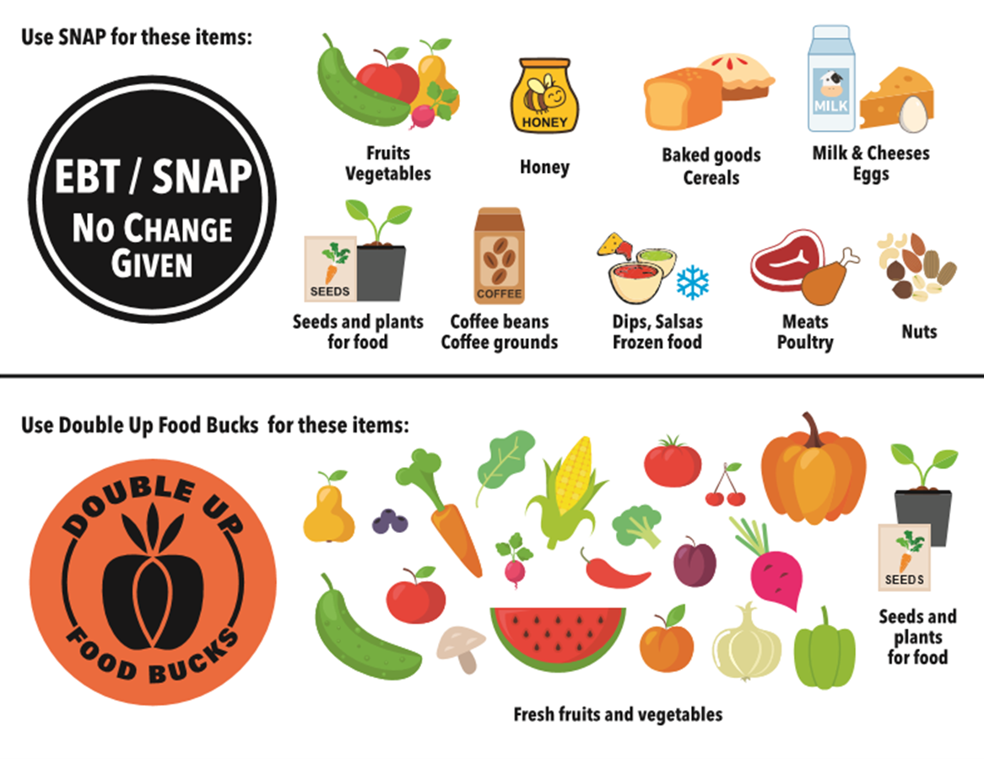
SNAP AND DUFB ELGIBLE PURCHASES
Notes:
All FRESH F&V and seed and plants that produce food. SNAP: F&V, meat, baked goods, etc. Not allowed: Any whipped or infused honey, ONLY plain honey. Also not allowed are hot foods, alcohol, tobacco, etc.

Slide 5
Taxes
Sales tax is not collected on Double Up tokens.
USDA considers incentives (matched dollars) for SNAP as SNAP dollars exempt from sales tax.
Vendors are encouraged to add extra items if sales tax is figured into your cost.
Notes:
If vendors do not figure in sales tax, and charge it at the end, this is moot. But, most vendors do figure sales tax into cost. Example: Basket of green beans-$4 with tax figured in. We encourage the vendor to add a small handful of green beans, or a zucchini to make up for the difference.

Slide 6
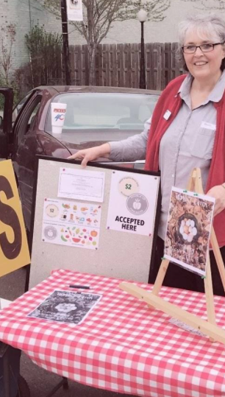
Benefits of Double up HeartlaND
Customer, DUFB Vendor, and Location Benefits
Customer
Fresh produce more affordable.
Local produce.
Health
Location
Increased customer awareness.
Farmers earn more money
Customers buying fresh produce also often buy other items.
Increase community awareness and support of locations.
Notes:
More produce moved, more support, more customers

Slide 7
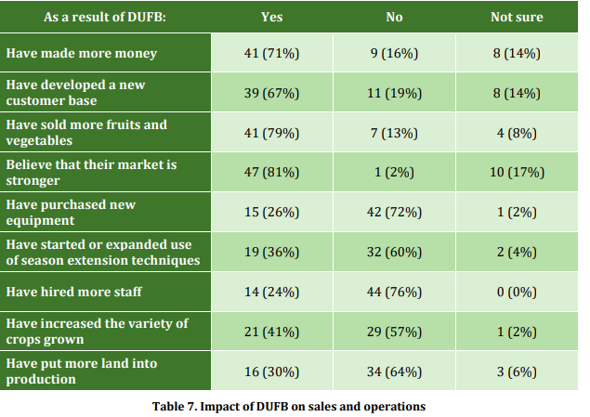
2020 SURVEY OF DUFB VENDORS IN KS/MO
Notes:
Feel free to remove this one- it’s our Heartland DUFB survey of DUFB vendors and the benefits of their program.

Slide 8
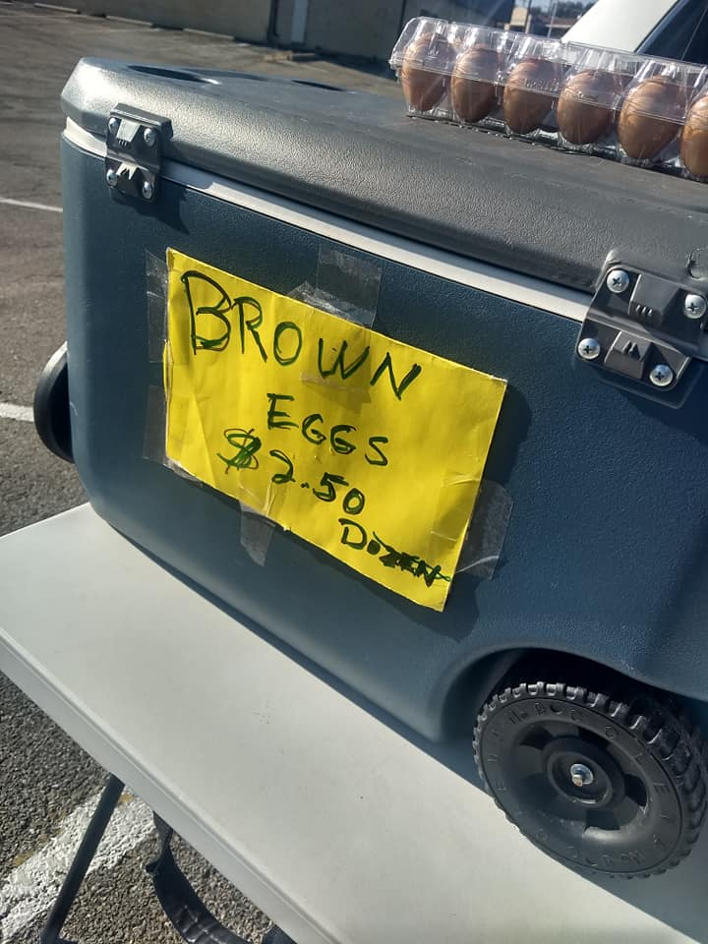
Benefits For non-Eligible vendors
Non-eligible vendors (meats, baked goods, prepared food, honey, and other items) increased their income from SNAP sales and cash because customers had more resources.
SNAP customers often bring other people with them to the market.
Notes:
Important to discuss the benefits to non-eligible vendors. It helps then have buy in to the program and support and promote it.

Slide 9
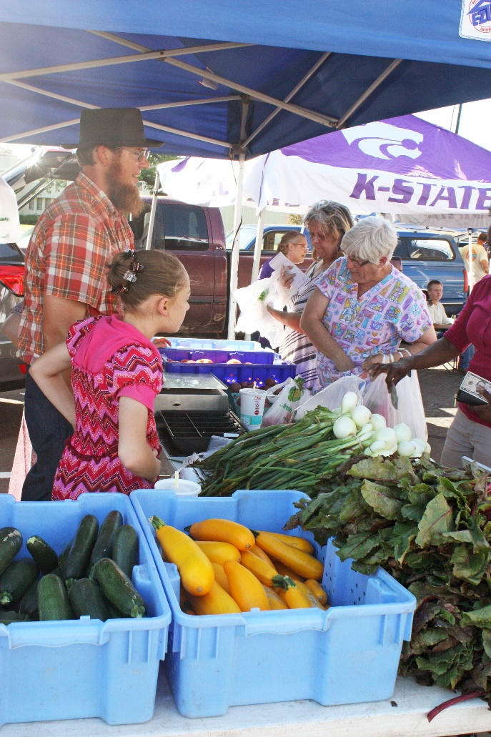
Make your market welcoming for Snap Customers
Have signage visible
Build a relationship with shoppers
Encourage your SNAP customers to spend their SNAP tokens on non-fruit and vegetable items to get the most out of their match and drive traffic to all types of vendors.
Remember that sometimes you might be selling to your neighbor- be intentional about reducing stigma
Vendors can help SNAP customers out by “rounding” prices down to the whole dollar for token users.
Education and recipes go a long way!
Notes:
Important. SNAP customers shop with folks that visible signage first, in our survey of SNAP FM shoppers, kindness goes a long way!

Slide 10
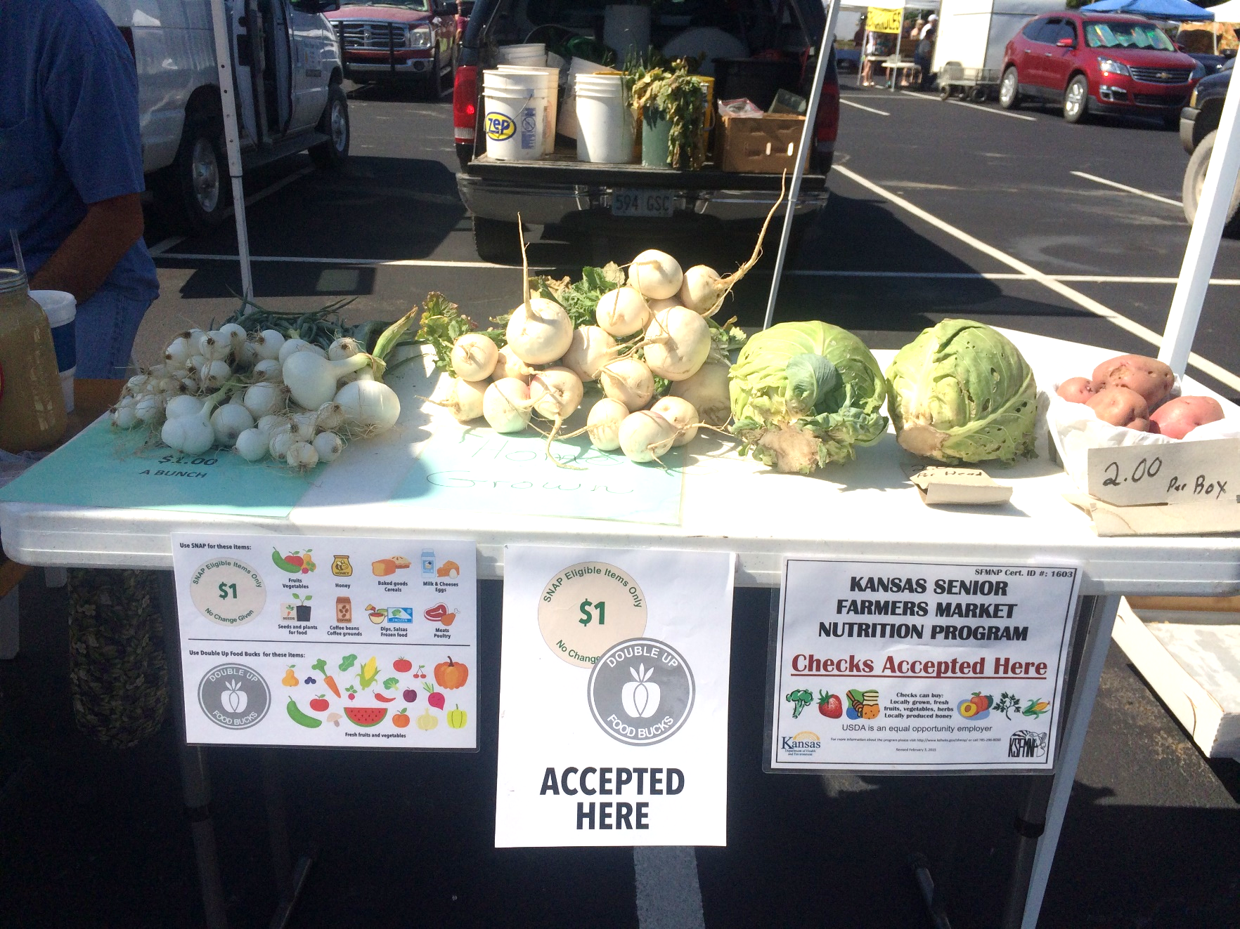
GOOD SIGNAGE IS IMPORTANT!

Slide 11
DUFB Customers
“I love it. At first, I was like this is going to be embarrassing because everybody knows you’re using coins, everybody knows that you’re EBT, but really- it didn’t really matter. Most of the vendors are really happy to take it… And to be able to double up to make my food stamps go further. That is what drew me to come there and try it. It has helped me to pay attention to food labels and what I am putting in my body and each vendor has taught me something about food. So that’s been great, because they know about food, they know their products…”

Slide 12
Double up heartland
Questions
Contact:
Erin Bishop DUFB Program Manager K-State Research and Extension erbish@ksu.edu
Notes:
Should we include market having funds to reimburse vendors? This was a challenge this year as they waited on checks to come. Just a thought.

